Slide 1
RIDGEBACK ADAPTIVE SECURITY
“It is not the strongest of the species that survives, nor the most intelligent, but the one most responsive to change.” - Darwin
Ridgeback Network Defense Inc.

Slide 2



TRADITIONAL SECURITY IS BEING BREACHED CONSISTENTLY
93% OF CASES HACKERS TOOK MINUTES TO BREACH
COMPANIES SPENT WEEKS OR MONTHS TO DISCOVER
Cyber Attacks are increasingly being frequent – “Organizations are either already hacked, or on the verge of being hacked, and both will be hacked again”
New forms of cyber attacks are emanating with more connected systems, users and devices – “Security teams need right fit cyber security solutions in detecting and blocking cyber threats and malicious intrusions”
LOST ASSETS 100x MORE PREVALENT THAN THREAT
CYBER ATTACKS COSTING $500B / YEAR
Overburden to Security Operations – “Monitoring team requiring clear visibility into security threats due to alarm fatigue in distinguishing real threats against false positives”
95% OF WEB ATTACKS ARE FINANCIALLY MOTIVATED
EVERY 7 SECONDS A NEW MALWARE IS RELEASED
Compliance is not security – “Compliance with standards while important step towards improving security posture are no assurance of cyber security”
NEARLY 30% OPEN PHISHING EMAILS
12% DO CLICK THE LINK OR OPEN ATTACHED FILES
Source: Verizon Data Breach Investigations Report

Slide 3


RIDGEBACK OVERVIEW
Ridgeback unique offering is designed to provide real-time visibility from external and internal malicious intrusion or communication, defend using hostile deception and real-time adaptive protection features. Solution
Real-time
Visibility
Ridgeback provides unprecedented visibility by filtering out bad traffic entering the environment and identifying suspicious attacker connections, notifies the security operations (SOC) with integrated monitoring capability
Hostile Deception
Ridgeback employs various Techniques to poison all information harvesting sources for the intruder. Hostile deception techniques is both dynamic & static
Real-time Adaptive Protection
Ridgeback deception mechanism provides situation awareness of malicious behavior, uses decoys to provide warning or extinguish threats and effectively reduces the risk

Slide 4
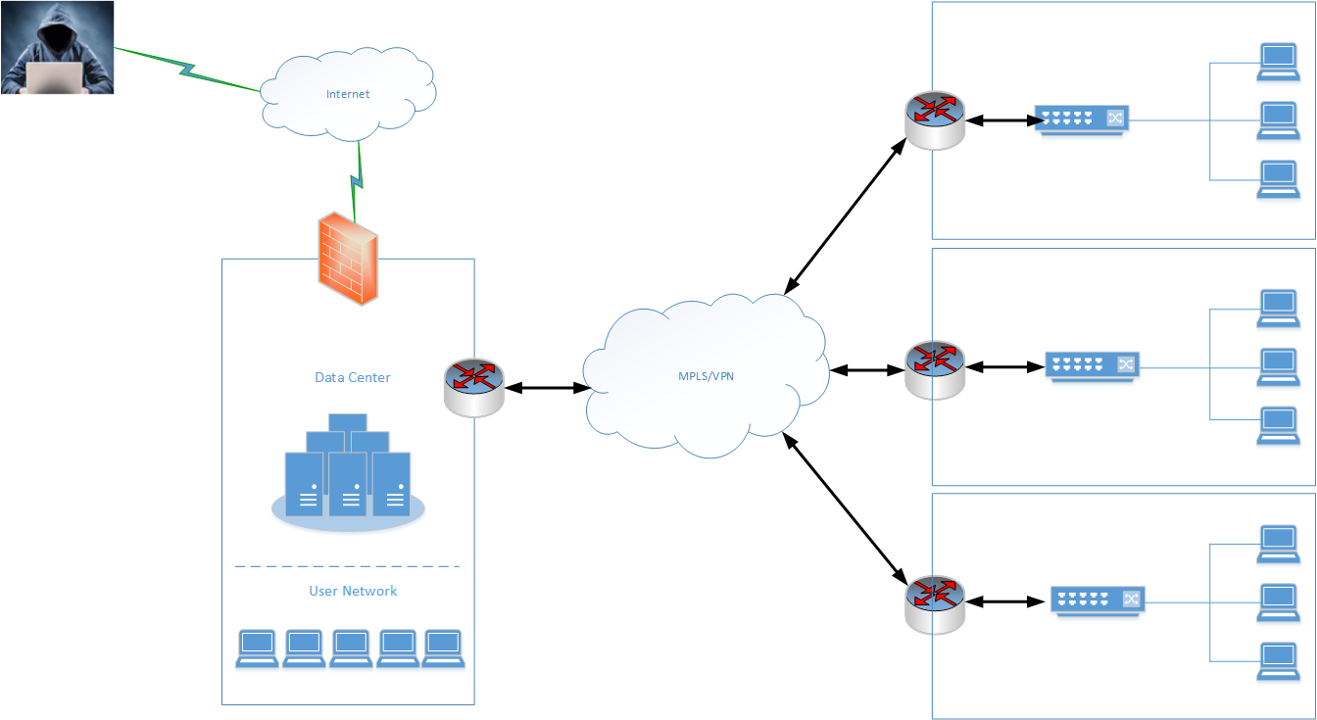
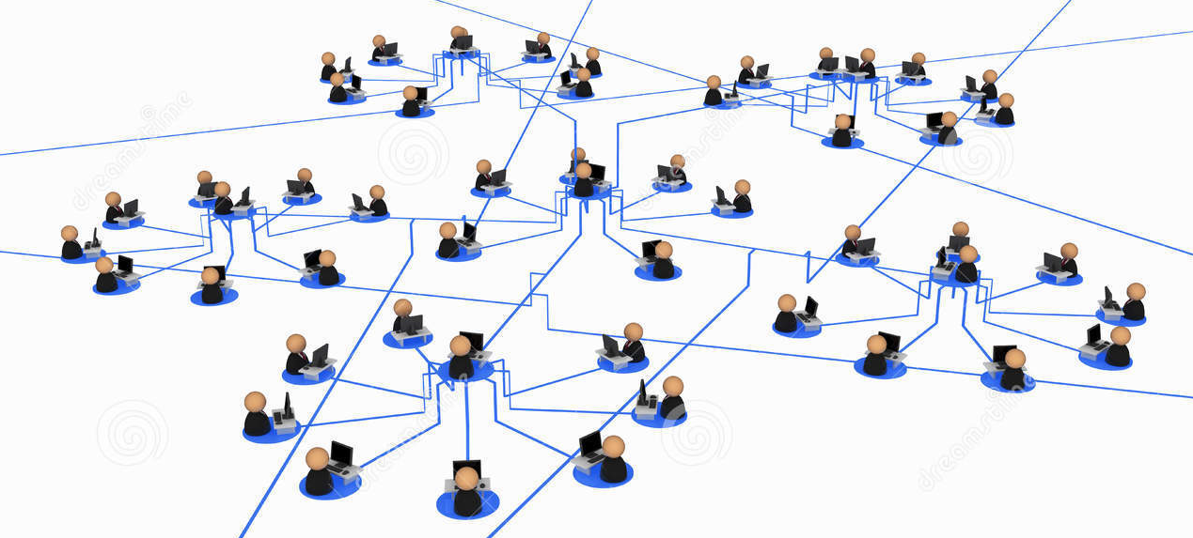


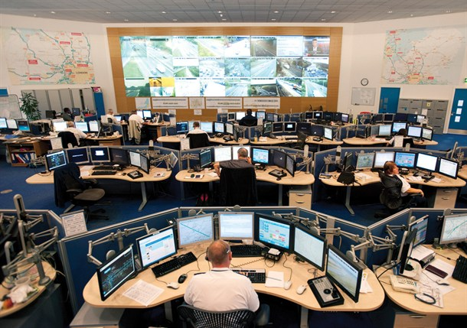


RIDGEBACK SOLUTION
Office network
Alerts
Alerts
External Reconnaissance
Monitoring
Command and Control Center
Firewall, IDPS, WAF, Sandbox
Extranet
Insider threats
Detect - Deceive - Defeat
Security Information & Event Management
Proactive Monitoring
Breach Detection
Session Isolation
Assets Awareness
3rd party Users
Machine Compromised
Software supply Chain/ Opensource code
Perimeter Security breached
Endpoint Security breached
Reconnaissance
Lateral Movement
Control over IT system
Business Disruption / Data exfiltration

Slide 5
RIDGEBACK IN SUMMARY
Provides visibility and discovery of all Network assets, capturing communication flows across all network devices/end-points
Poisoning of all information harvest sources and comprehensive policy settings to intercept un-authorised network movement
HOSTILE
DECEPTION
COUNTER MEASURES
COMPLIANCE
INTERACTIVE VISIBILITY
SECURITY POLICY & NETWORK MONITORING
Out of box reporting and integration with other COTS products
Continuous monitoring in standalone mode and Open API Integration with most enterprise monitoring / SOC investment tools
Alerts for Policy violation around un-authorised movement and intrusion eviction from the network in auto/manual mode

Slide 6
PLUG-N-PLAY DEPLOYMENT AND OPERATIONAL EASE
Plug – n – Play Deployment
Operational Ease
Extremely small product footprint
Agent-less
Quick and simple to install
No network modifications
Not resources and labour intensive
Industry Agnostic
Autonomous & Real Time Operation
Highly Scalable
No learning curve for people
No more Big Data problems : 100% accurate
Easy Integration with the ecosystem
Effective management of network policy & compliance
Forensic Analysis & Compliance Reports

Slide 7
RIDGEBACK BENEFITS
Real time visibility & Monitoring of Network Hygiene
Factual Monitoring : Elimination of False Alerts, Zero False Positives
Ease of deployment : Agentless and scalable across all types of networks
Obfuscate Intruder’s network Monitoring : Hostile Real Time deception
Minimal training needs
Integration with existing investments
Supports Compliance requirements

Slide 8
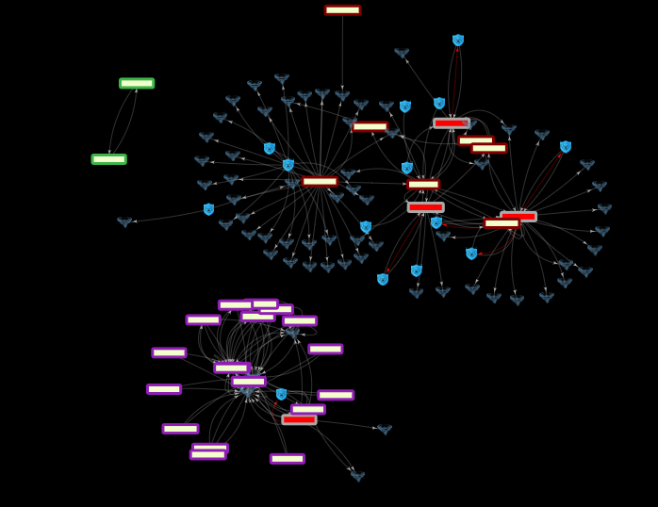
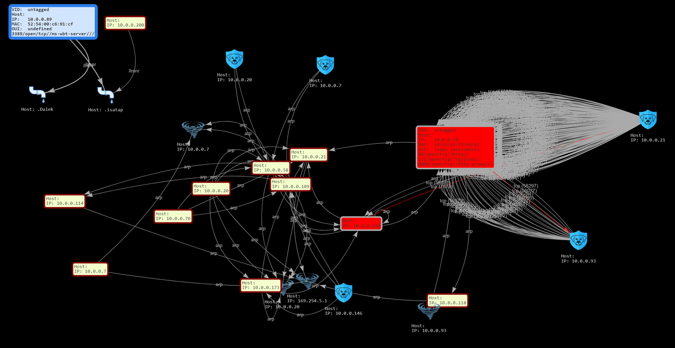
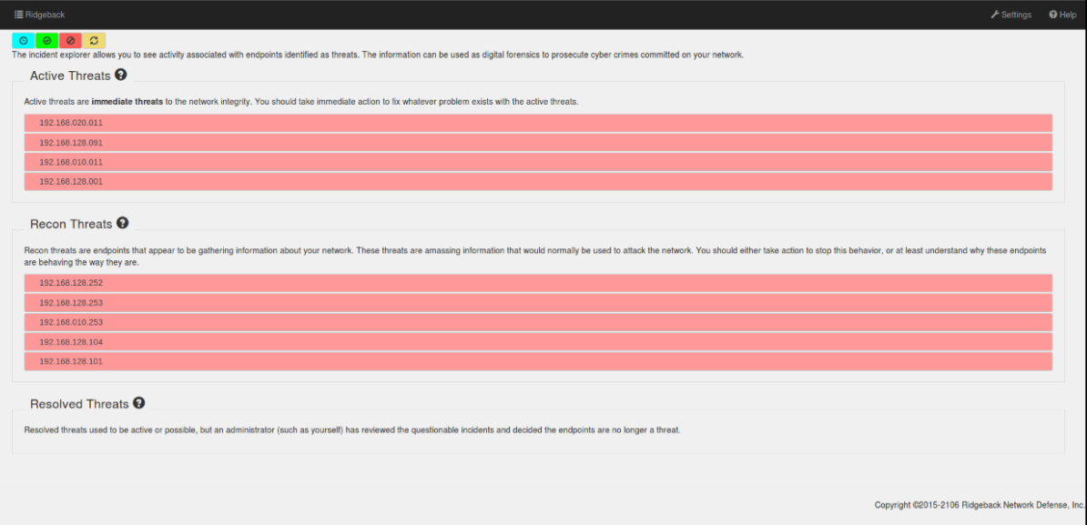
RIDGEBACK: ILLUSTRATIVE SCREEN VIEWS
Network Graph
Centralized View across the organization
Unparalleled Visibility across the entire organization providing details about Network Architecture and Communication
Real time visibility into the Threat Landscape across the organization
www.ridgebacknet.com

Slide 9
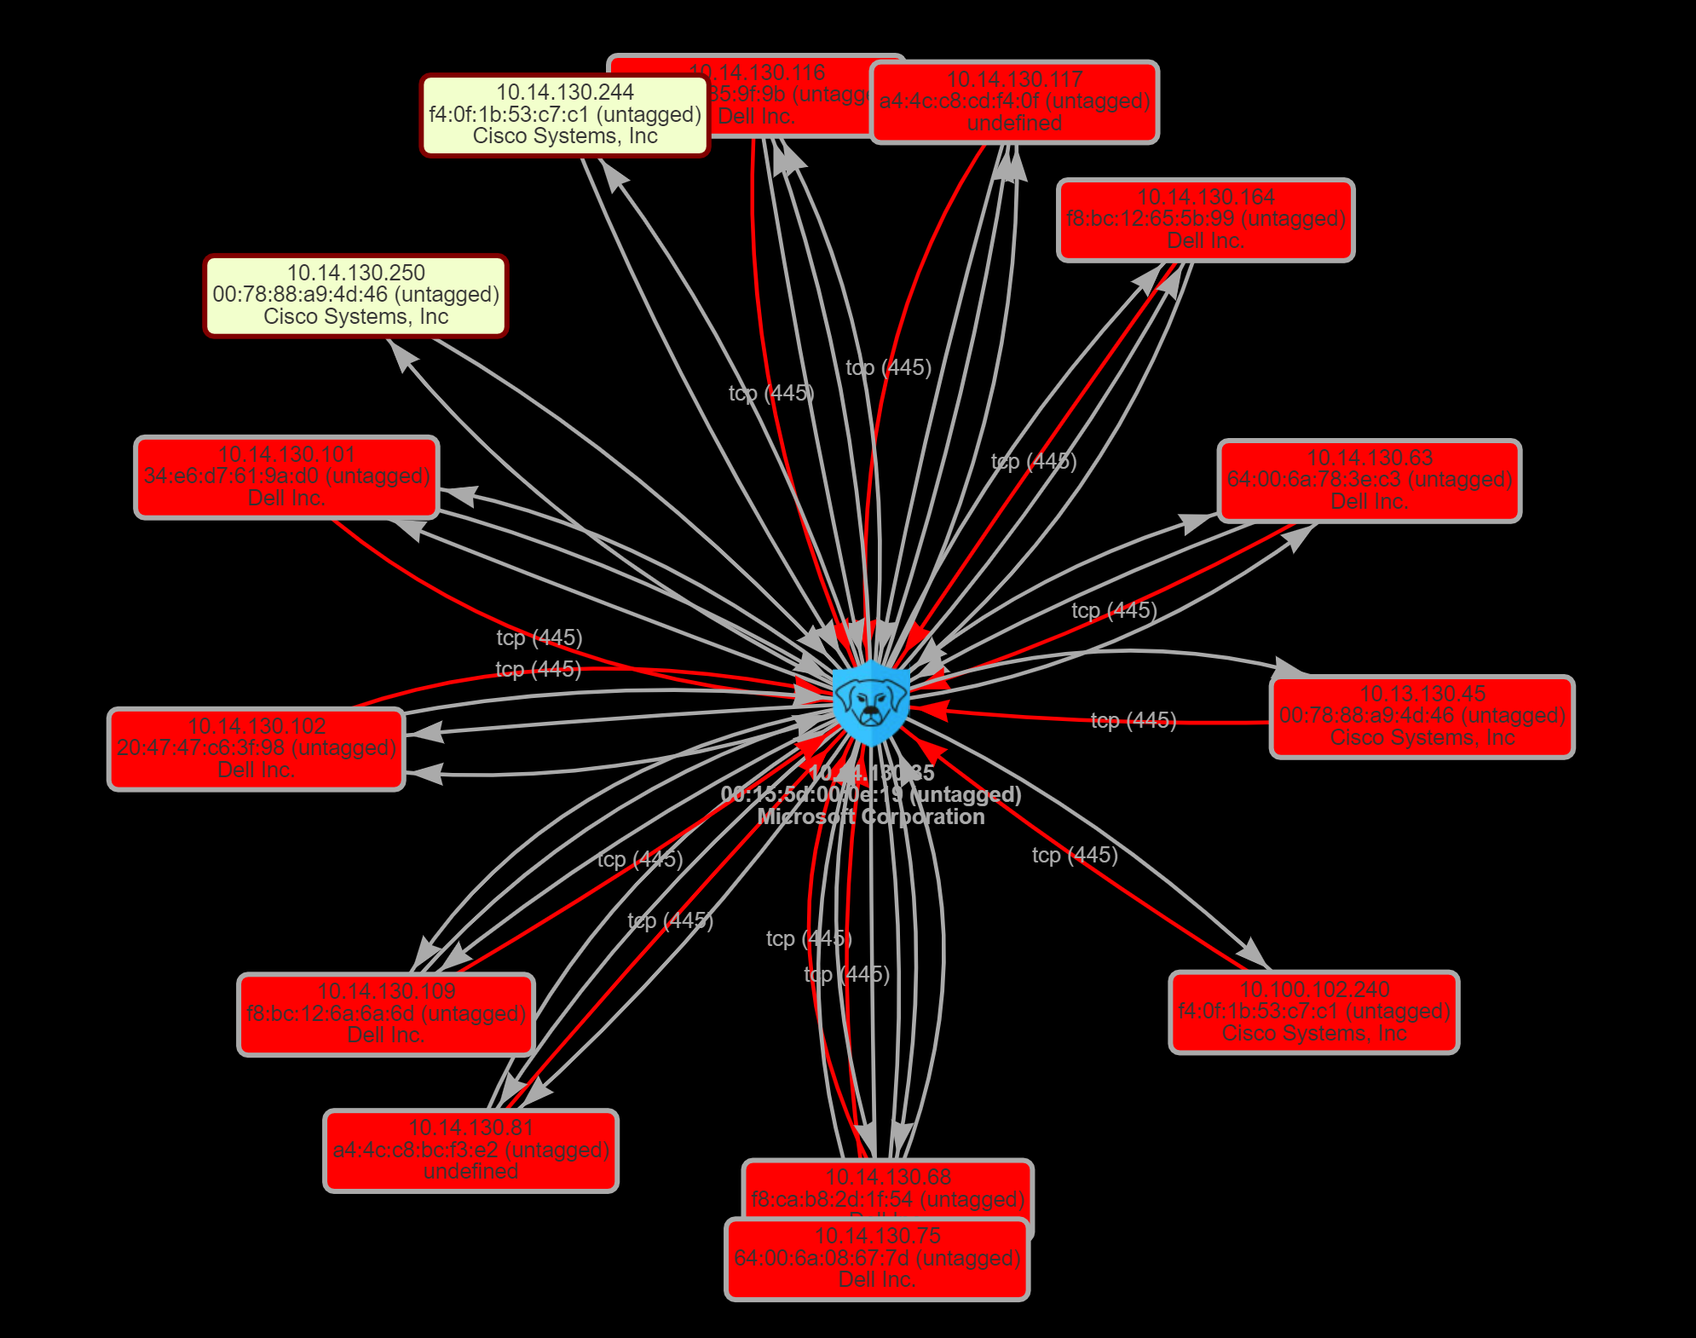
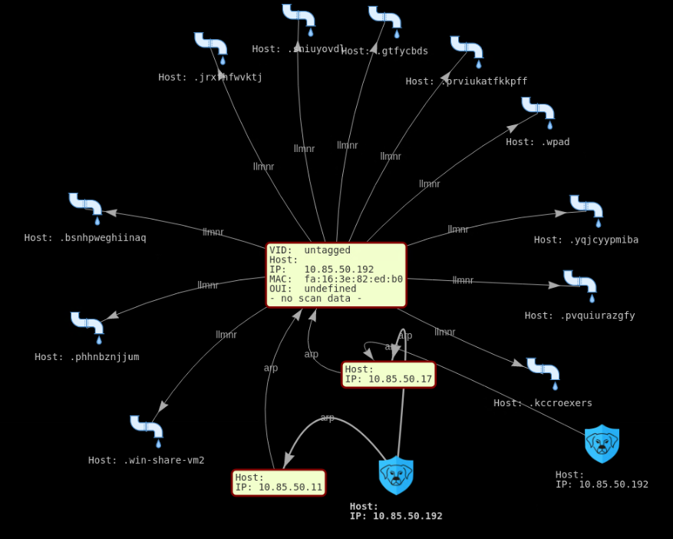
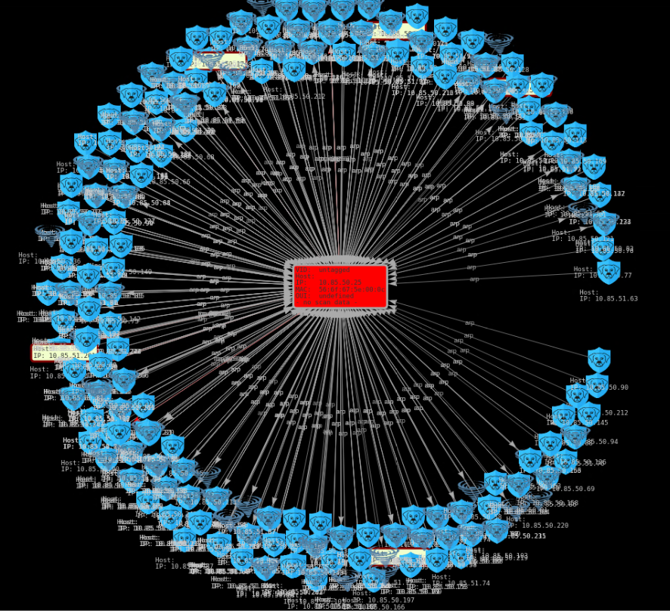
RIDGEBACK: ILLUSTRATIVE SCREEN VIEWS
Detection of missing assets, Indication of possible threat - Ideal scenario for Man-in-the-Middle
Detection of new threats - For e.g. LLMNR: One of the biggest targeted threats to internal network environments today that leads to credential theft
Active Reconnaissance indicating effort to gather information across the network
www.ridgebacknet.com

Slide 10
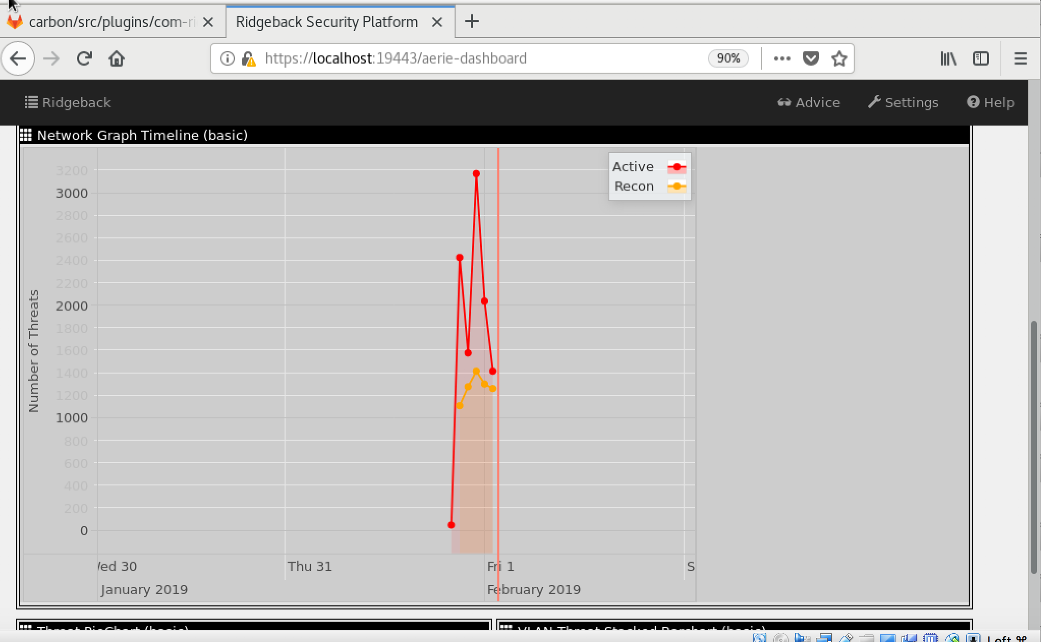

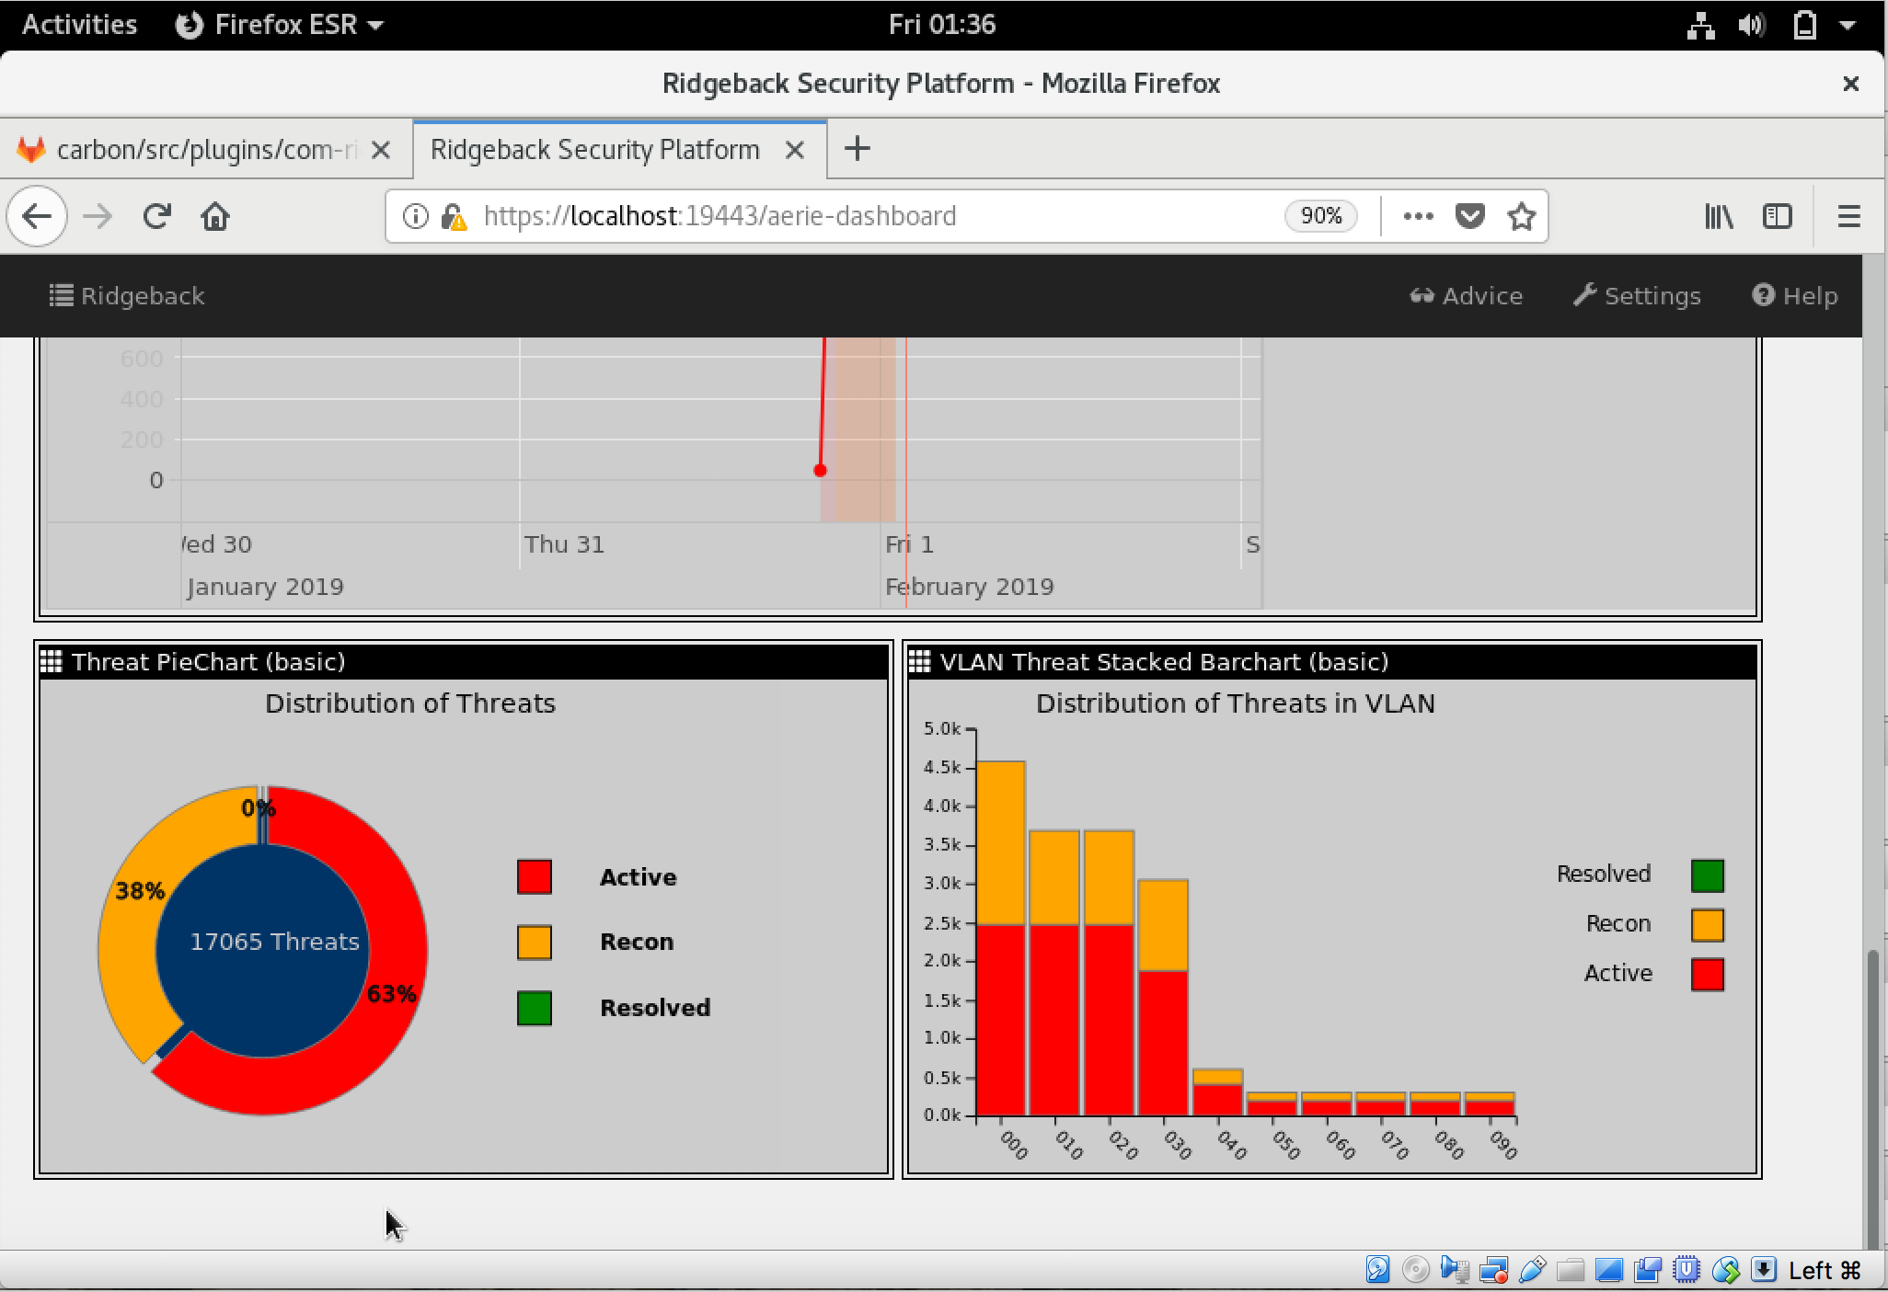
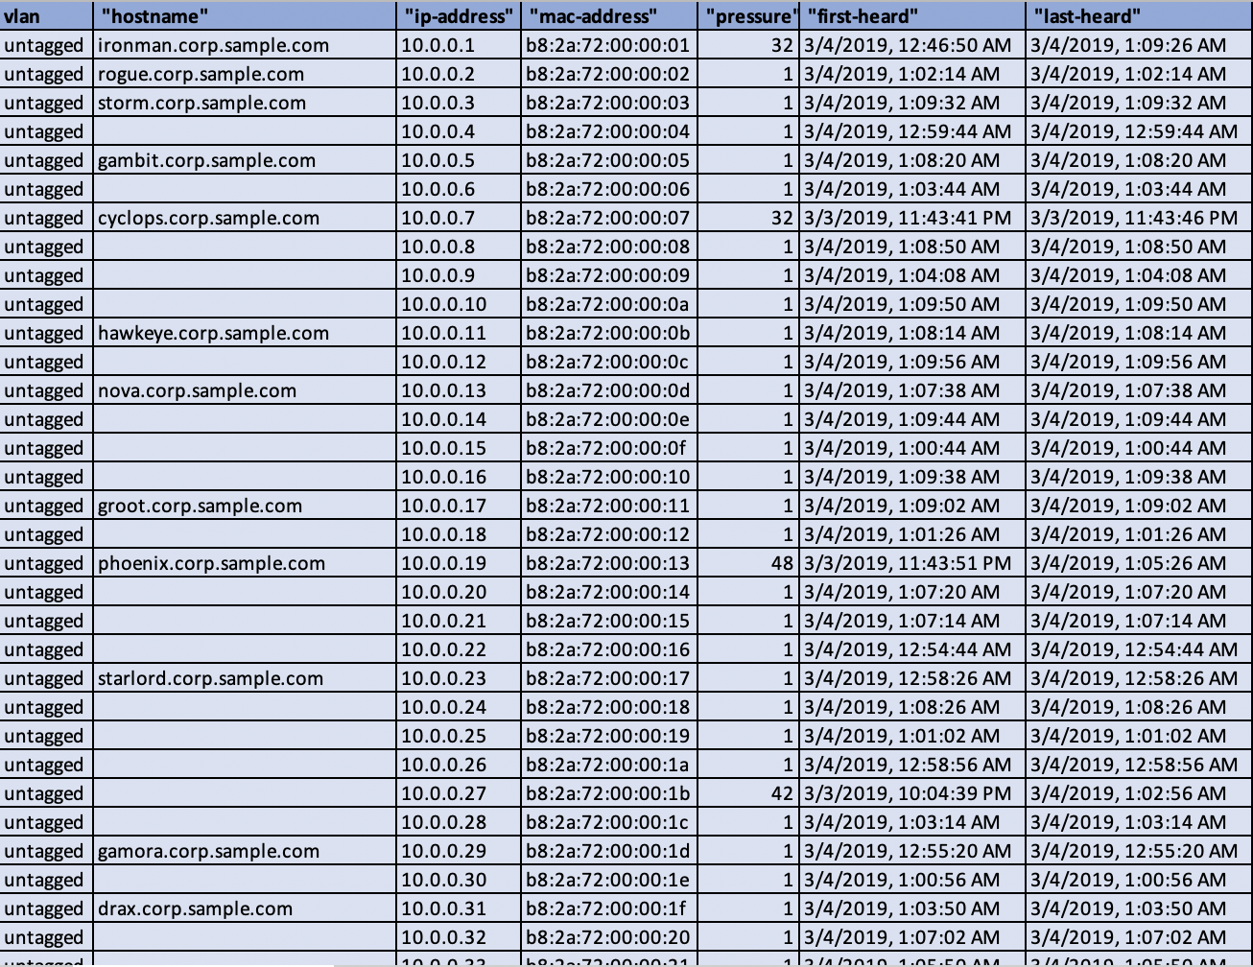
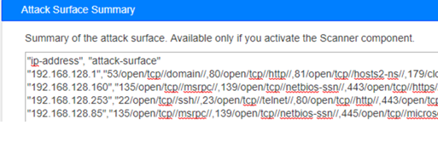
RIDGEBACK: REPORTS DASHBOARDS & ATTACK SURFACE
Sample management dashboards

Slide 11






TEAM AND LOCATIONS
Thomas Phillips
CTO/FOUNDER
Scott Fogarty
CO-CEO
Raj Kulkarni
CO-CEO
Suren Kulkarni
VP - APAC
Amol Vedak
SVP - Europe & Africa
Head Quarters
Development Centers Sales offices
Baltimore, Maryland, USA.
Baltimore, USA and Pune, India.
Washington DC, Boca Raton, London, Paris, Pune
www.ridgebacknet.com

Slide 12
FEEDBACK & NEXT STEPS
Any questions
What are your key challenges, how can we offer support
Use cases specific to your requirements
Building a Proof of Concept at your environment
Next steps and points of contact
www.ridgebacknet.com

Slide 13

Suren Kulkarni Vice President suren@ridgebacknet.com
Dynamic,
Interactive
Defense
Real-time
Protection
IoT
Embeddable

